Slide 1



PROJECT
DS 203
Prof : Vinay Kulkarni

Slide 2




Het kotadiya
23B0610
Kanishk Sehra
23B0699
Karan Patel
23B0632
Vishwat Dubey
23B0674

Slide 3

1
Approach
Sections
2
EDA
3
Model
4
Web-app
5
Conclusions & Problems faced

Slide 4


Problem Statement
Given a jumbled set of lecture sessions and summaries, the goal is to re-establish which summary belongs to which session using text similarity techniques and then provide the top 3 summaries of that session to build insights and applications around the data.

Slide 5

Approach

Slide 6
1. Data Loading & Preprocessing
Removed duplicates and converted all text to lowercase.
Tokenized summaries and cleaned stopwords.
Computed word counts and detected short or incomplete summaries.
Created and cleaned summary versions for modeling.
2. Feature Engineering
Used 3 techniques to featurise summaries:
TF-IDF
Universal Sentence Encoder (USE)
SBERT
3. Clustering
Use K-means clustering to cluster them into 20 groups (lectures).
Used RandomForestClassifier to make a prediction function.
Ranked the summaries of predicted clusters and gave the top 3 summaries.
4. Interactive Webapp
Created a simple working web app using Streamlit

Slide 7



Exploratory Data Analysis (EDA)

Slide 8

Overview of the Dataset and changes applied:
Total summaries: 668
Duplicates removed: 1
Short summaries (<5 words): 1
Carried out tokenization
Stopword removal
Total words (with stopwords): 142965
Most common words before cleaning : the , we , of , and , to , is , a , data , in , for.
Total words (without stopwords): 90034
Most common words after cleaning : data , Regression , model , values , sample , linear , mean , class , features.

Slide 9
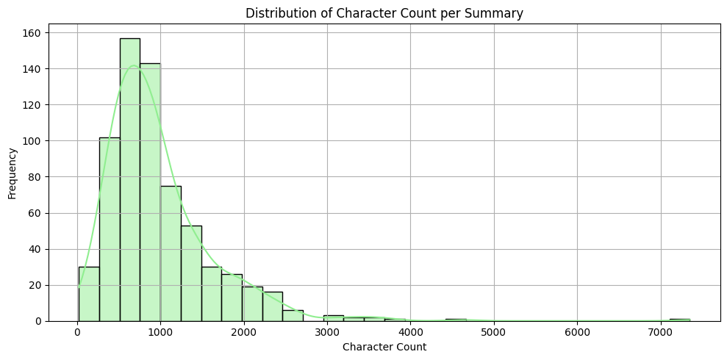
This graph shows how many characters are used in summaries, most of them in the 500-1000 character range.

Slide 10
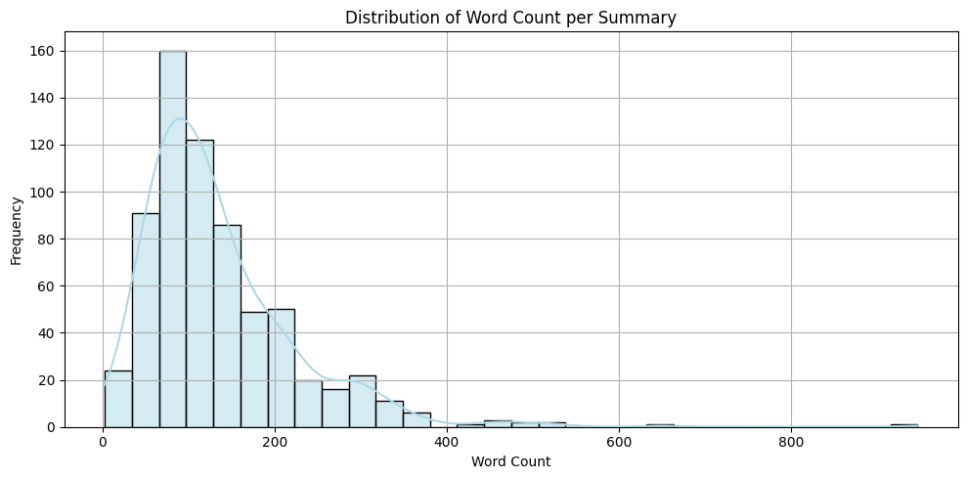
same way, this graph shows how many words are being used in summaries
Most of them are in the 60-120 word range.

Slide 11
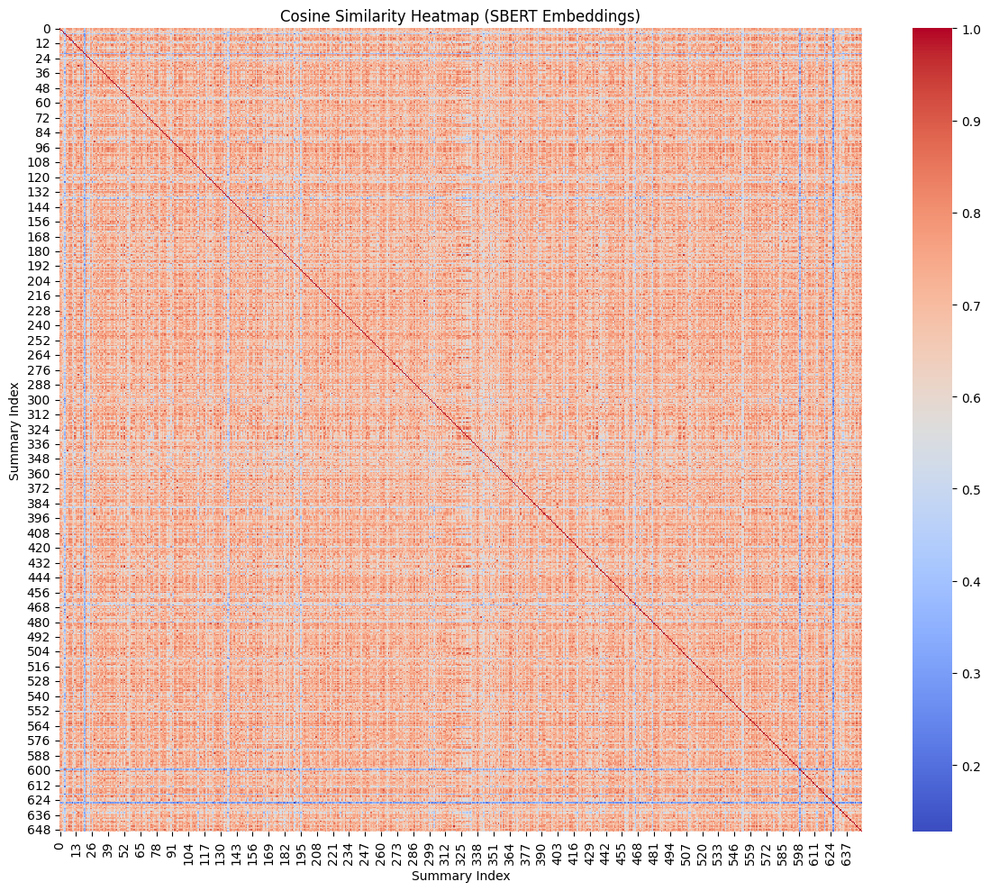
heatmap of cosine
Similarity of all the summaries
We can not tell much from this because of the large dataset

Slide 12
TEXT FEATURIZATION
We used 3 featurization method.
Used cosine similarity to find out which is the best method.
Ranking of them are as follows :
SBERT
USE (Universal Sentence Encoder)
TF-IDF (Term Frequency-Inverse Document Frequency)
TF-IDF relies on the frequency of words used in the sentence, neglecting its meaning
Treats each summary as a bag of words.
Tries to match summaries to lectures based on word overlap and frequency
While USE & SBERT turns each summary into a dense vector capturing the overall meaning, which is good for semantic understanding, it doesn't care about exact word matches. That is more suitable in our case.

Slide 13


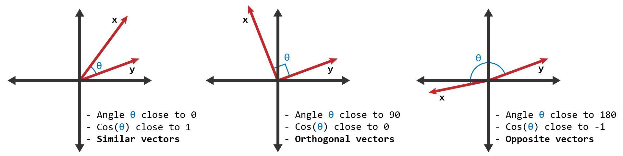
Metrics used to decide which featurization to use:
Cosine Similarity: Did this by checking if similar inputs have similar vectors (high cosine similarity) and dissimilar inputs have low similarity.

Slide 14
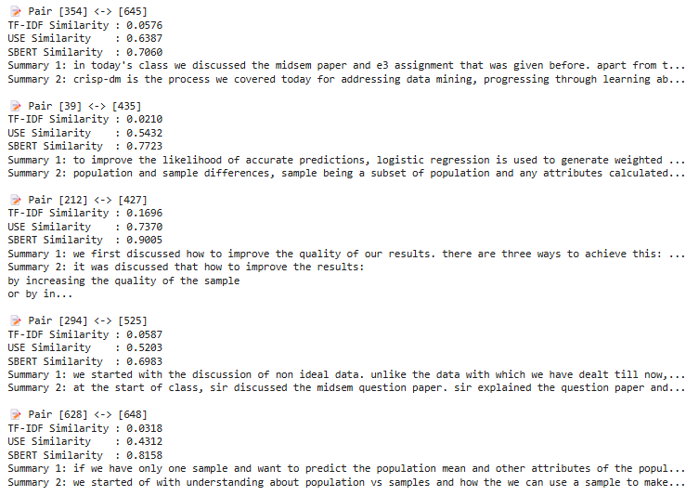
Cosine similarity of 5 randomly generated summaries across all 3 featurization methods:
Here, we can see that for the same summary pair, SBERT shows the highest cosine similarity while TF-IDF shows least cosine similarity

Slide 15
We compared the performance of TF-IDF, USE, and SBERT on the same randomly generated summary pairs using cosine similarity. SBERT & USE consistently assigned higher scores to semantically similar summaries, while TF-IDF struggled to capture context. This shows that SBERT & USE are the most effective feature extraction methods for our session summary matching task. But since SBERT is not time efficient, we used USE since it shows similar results with less time

Slide 16
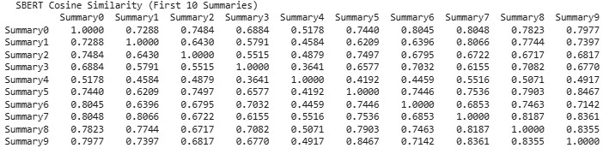
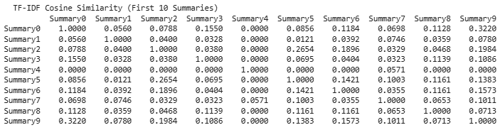
Here is the cosine similarity matrix for the first 10 summaries for comparisons

Slide 17
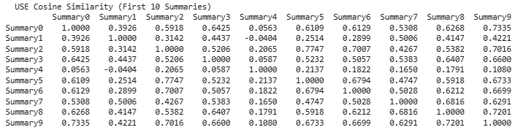
Here is the cosine similarity matrix for USE featurization for the first 10 summaries, which is significantly better than TF-IDF, faster than SBERT, while providing almost same results
Now that we have decided to use USE embeddings, we will focus on clustering this summary.

Slide 18
CLUSTERING

Slide 19
Clustering the Summaries:
Applied K-Means Clustering (k=14) to group summaries into 14 clusters (one for each session).
Each cluster represents a lecture/topic based on the semantic similarity of the summaries.
Why K-means?
K-Means is a fast and scalable clustering algorithm.
It works well when you have a predefined number of clusters, like our 14 lectures.
Easy to implement and interpret.
Universal Sentence Encoder (USE) gives us dense numeric vectors for each summary.
K-Means naturally works on vectorized (numerical) data.
Each summary is embedded in a high-dimensional space → K-Means groups similar vectors together.

Slide 20
How to decide the number of clusters?
Elbow Method:
This uses a Within-Cluster Sum of Squares (WCSS), which measures how tightly the data points are clustered around the centroids.
The idea is to plot WCSS against the number of clusters (k) and look for an "elbow" point — where the rate of decrease sharply changes, suggesting a good number of clusters.
Silhouette Score:
This evaluates how well each point fits within its cluster compared to other clusters.
It ranges from -1 to 1, where higher values indicate better-defined clusters.
So we use this method to decide how many clusters/lectures we should divide this into

Slide 21
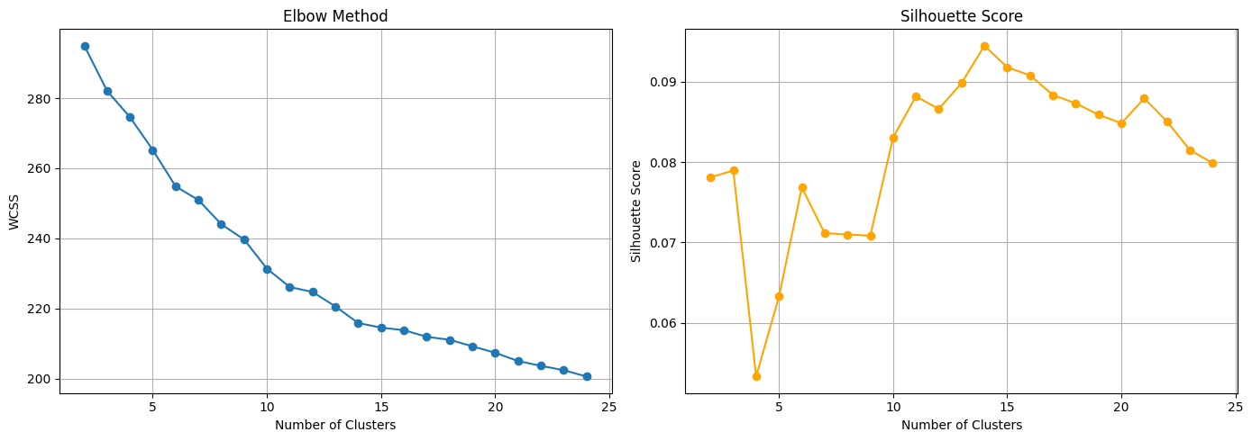
A better Silhouette score means better results, so we take the number of clusters(k) such that we get maximum silhouette score.
Here, it is at k=14 when we get the highest score; that is why we took a number of clusters as 14. which indeed makes sense practically as well

Slide 22
After the clustering is done, we plot t-SNE & UMAP plot for better visualization of clusters
t-SNE
t-SNE stands for t-distributed Stochastic Neighbor Embedding.
It's a dimensionality reduction technique.
Mostly used to visualize high-dimensional data (like word embeddings, image features, etc.) in 2D or 3D.
It tries to preserve local structures in data, meaning it keeps similar points close together in the low-dimensional projection.
It's especially good for visualizing clusters or patterns in complex data.
Points that are close together in the original space should appear close together in the plot.
It’s not a curve in the mathematical sense — more of a visual representation.
close originally.

Slide 23
2. UMAP
UMAP is a dimensionality reduction technique, similar to t-SNE, but it's often faster and preserves more global structure. It's particularly useful for visualizing high-dimensional data like embeddings, document vectors, or gene expressions.
How It Works
Construct a Graph in high-dimensional space:
It models the local neighborhood of each data point.
Optimize a Low-Dimensional Graph:
UMAP tries to preserve this neighborhood structure in a low-dimensional space (typically 2D or 3D).
Uses Manifold Theory + Fuzzy Topology to find a layout that keeps points close if they were

Slide 24
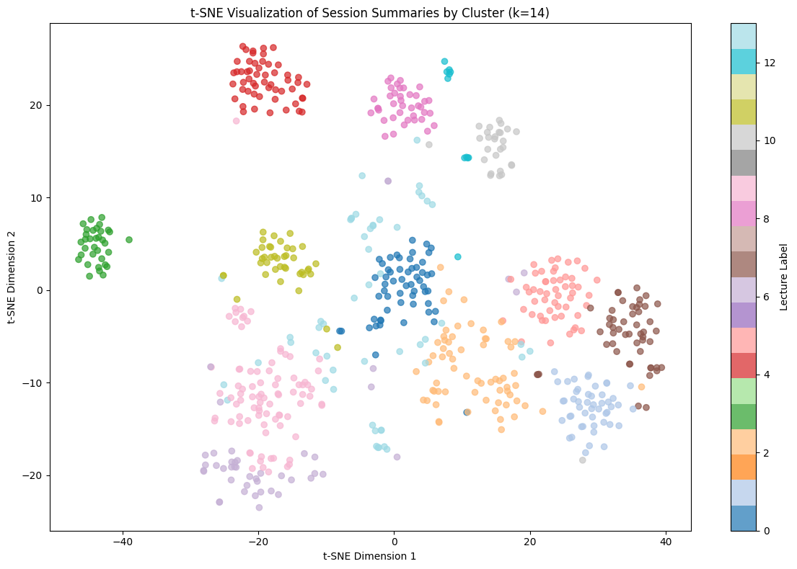

Slide 25
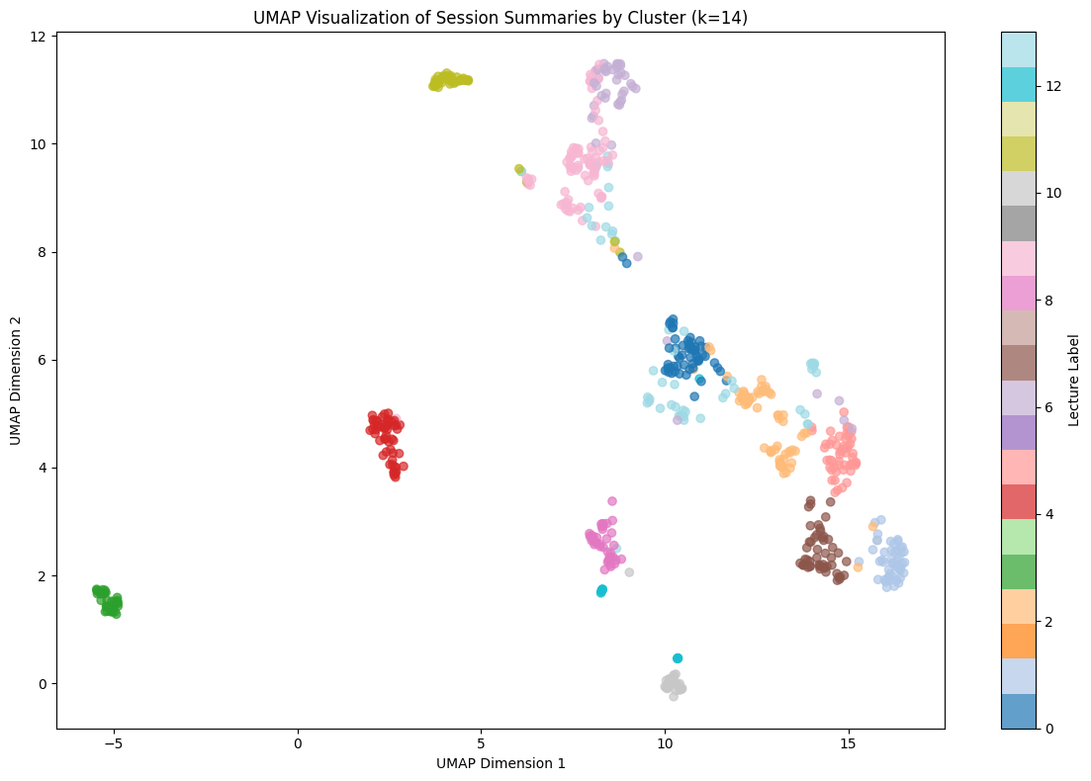

Slide 26
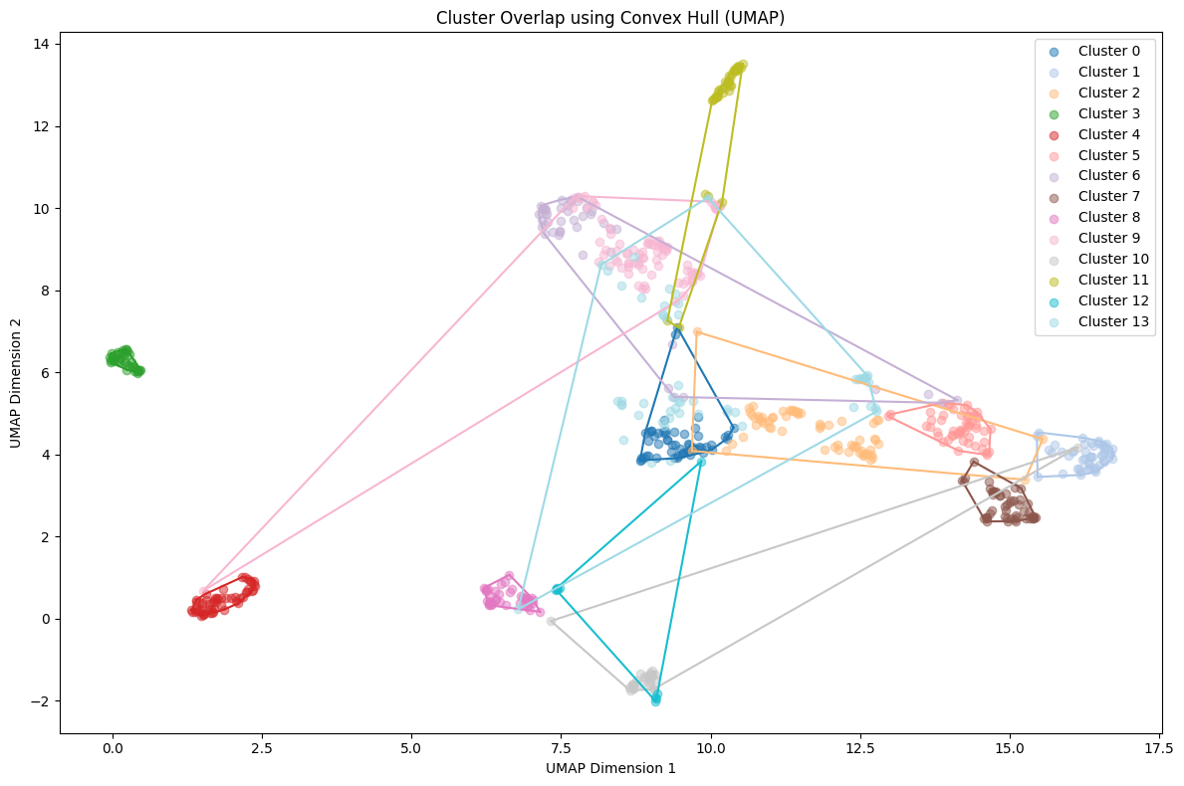
For better visualization of overlapping, we add a convex hull to each cluster

Slide 27
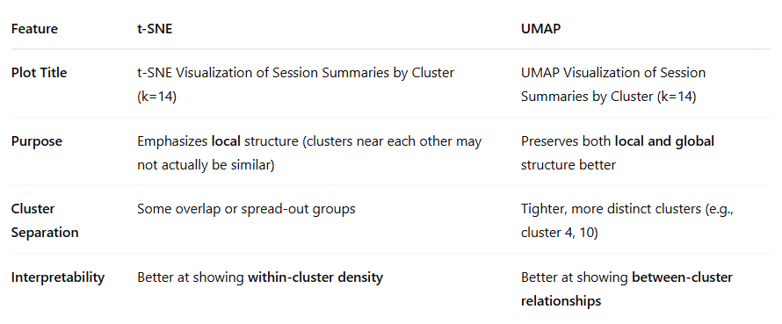
OBSERVATIONS

Slide 28
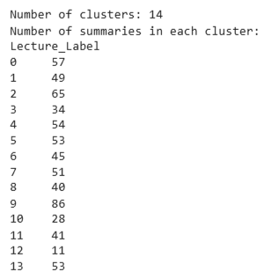
We also got information on how many summaries lie in each lecture labeled 0-13.
We stored this information in “Cluster_Summary_Counts.csv”
Cluster 9 is the largest, possibly representing a broad or common topic.
Cluster 12 is the smallest, which might indicate a niche or very specific theme.
Most clusters have between 40 and 57 summaries, suggesting relatively balanced grouping.
We also store all the clustered summaries in the file Clustered_Summaries.csv

Slide 29
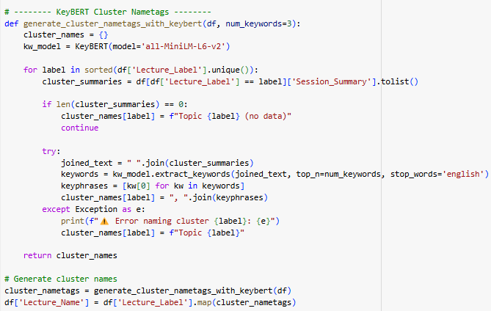
Labeling the clusters
Function: generate_cluster_nametags_with_keybert(df, num_keywords=3)
Loops through each unique cluster label in the DataFrame.
Gathers all session summaries for that cluster.
Uses KeyBERT (with the all-MiniLM-L6-v2 model) to:
Join all the text in the cluster
Extract top N keywords/phrases
Builds a cluster name using these keywords.
Handles errors or empty clusters gracefully.
When we cluster our summaries, it provides numbers 0-13 randomly which is quite inconvenient, so we give each cluster a name based on its content.

Slide 30
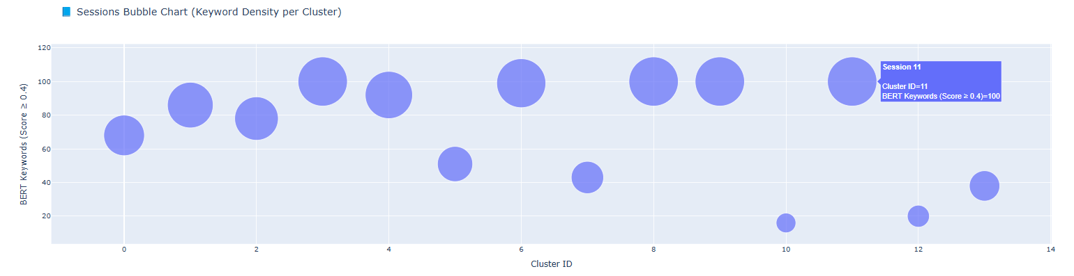
Exploring Topic Density Across Session Clusters with BERT and KeyBERT
Objective:
The aim was to analyze the thematic depth—or topic density—within various session clusters. To achieve this, we sought an effective approach to visualize the number and quality of contextually relevant keywords present in each cluster.
Tools Utilized:
BERT (all-MiniLM-L6-v2): Used to create semantic embeddings of session summaries.
KeyBERT: Leveraged for keyword extraction based on semantic relevance using BERT embeddings.
Plotly: Employed to generate an interactive bubble chart for visual representation of topic density.

Slide 31
PREDICTION

Slide 32
Cluster Prediction Process Overview
1. Cluster Assignment (Topic Prediction)
To determine which cluster (or topic) a new session summary belongs to, the summary is first embedded into a high-dimensional vector space using a pre-trained language model(USE). This vector is then compared to the centroids of all pre-defined clusters using similarity measures. The summary is assigned to the cluster whose centroid is most similar, indicating that its content closely aligns with the core themes of that group.
2. Prediction Confidence (Cosine Similarity to Centroid)
Once a summary is assigned to a cluster, the confidence of this prediction is quantified by calculating the cosine similarity between the summary's vector and the centroid of the predicted cluster. This value represents how well the summary fits within the cluster:
A high confidence score suggests strong alignment with the cluster’s thematic content.
A lower score indicates the summary may be on the periphery or contain mixed themes.

Slide 33
3. Top-N Similar Summaries (Reference Matches)
To provide further context for the prediction, the top-N summaries within the predicted cluster that are most similar to the new input are identified. These summaries are ranked based on their cosine similarity to the cluster centroid. Displaying these examples helps illustrate the reasoning behind the cluster assignment and enhances interpretability by highlighting comparable content already present in the dataset.

Slide 34
Word cloud

Slide 35
Word Cloud Analysis of Session Topics
1. Overview :
This analysis uses word cloud visualizations to uncover the key concepts discussed within individual lecture sessions and across the entire course. Word clouds visually emphasize the most significant terms by varying word size according to their frequency or relevance.
To provide both local and global context, two types of word clouds were developed for each session:
Session-Specific Word Cloud
Highlights terms that are particularly important within a single session.
Global Word Cloud
Displays terms based on how frequently they appear across all sessions.
This dual approach was designed to offer insights into both the detailed content of each session and how it connects to the broader curriculum.

Slide 36
2.Key Insights
The visualizations illustrate the progression of course content — from foundational topics (e.g., measurement levels) in earlier sessions to more advanced analytical techniques (e.g., regression and classification) in later sessions.
Comparing local (session-specific) and global (course-wide) word usage reveals:
The primary focus of each session.
How does each session contribute to the overall structure and objectives of the course?

Slide 37
3. Why This Matters :
This method is valuable for several reasons:
Efficient Content Review
Quickly identify key topics for revision or summarization.
Curriculum Development
Trace the logical flow and depth of topics to support content progression and instructional design.
Learning Insights
Analyze student engagement and focus areas using real discussion data.
Knowledge Tracking
Monitor how subject matter understanding develops over time across sessions.

Slide 38
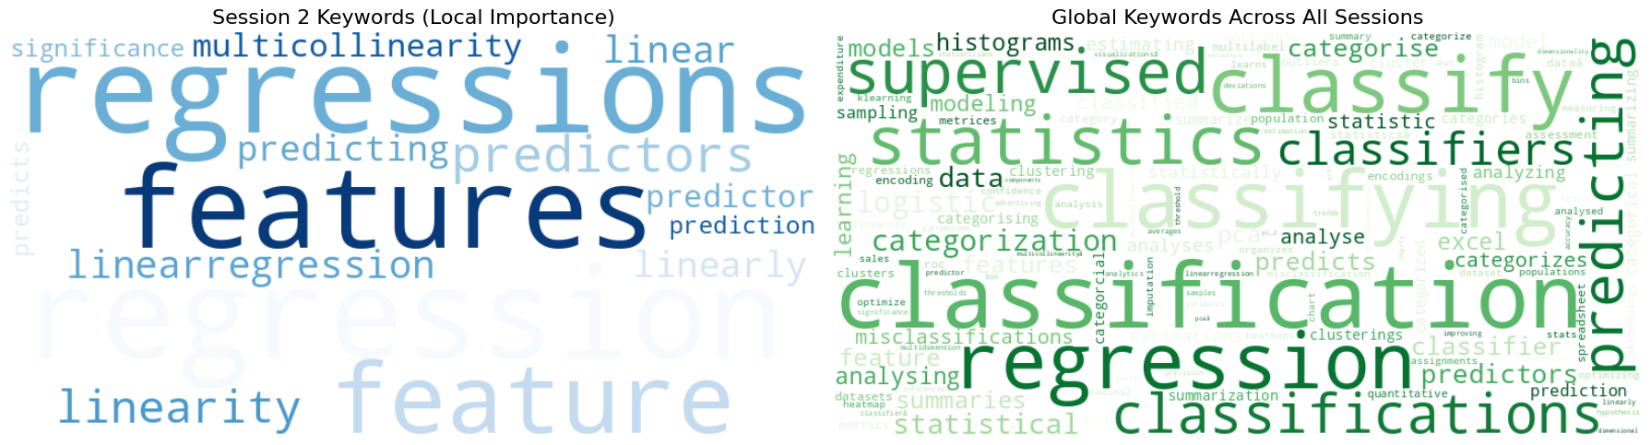
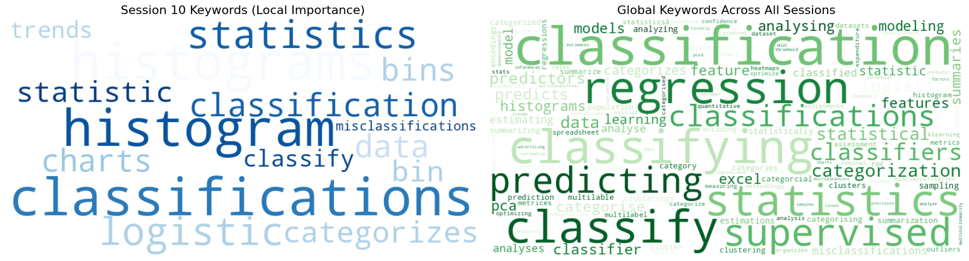
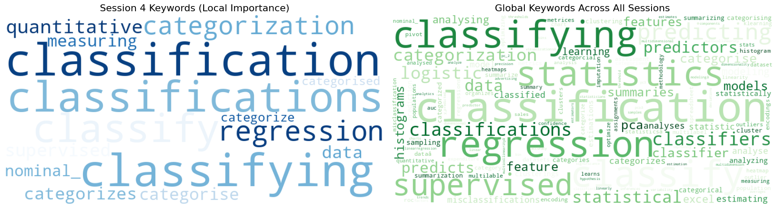

Slide 39
WEB-APP

Slide 40
Session Summary Finder – An Educational Tool
1. Overview:
This is an interactive web application designed using Streamlit to enhance educational content discovery.
2. Key Features:
Provides a user-friendly interface for entering keywords related to specific topics.
Automatically locates the most relevant lecture session based on the input.
Presents the top 3 most relevant summaries from the selected session for easy review.
3. Technologies Used:
Python and Streamlit for front-end and back-end development.
Utilizes pre-processed and structured summaries for fast and reliable access.

Slide 41
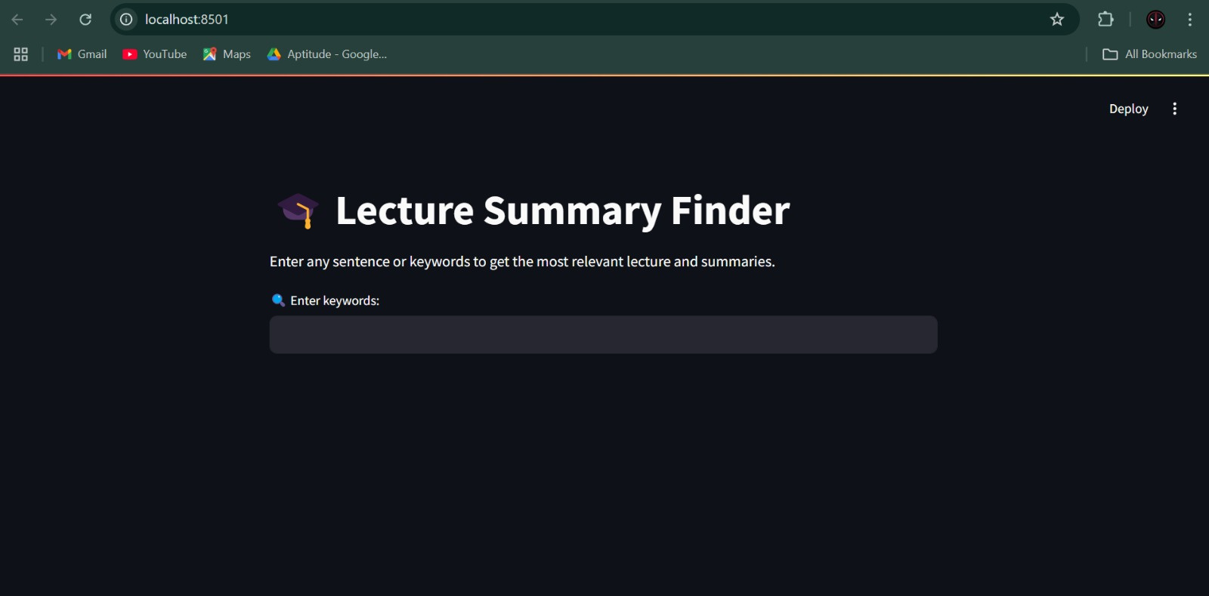
1.User enters topic-related keywords (e.g., "regression, gradient descent").
2. The app compares keywords against all available session summaries.
3.It identifies the session that is most relevant based on similarity scoring.
4.It then displays the top 3 most relevant summaries from that session.
5.It also shows the similarity of cluster centroids (confidence interval).

Slide 42
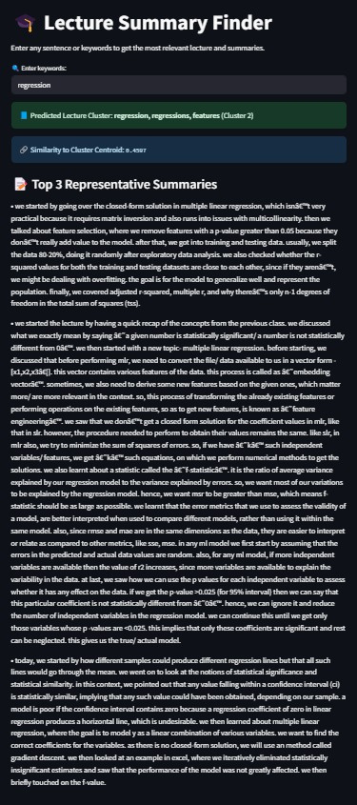

Slide 43
CONCLUSION & DIFFICULTY’S FACED

Slide 44
CONCLUSION
Enables precise identification of sessions where specific topics are covered.
Perfect for quick reviews ahead of exams or assignments.
Supports content mapping for curriculum redesign or updates.
Assists instructors in identifying redundant or under-emphasized areas.
Facilitates personalized learning by helping students revisit sessions aligned with their learning gaps
DIFFICULTY FACED
The major difficulty we faced was figuring out the right combination of text featurization and clustering methods that worked.
Since the project required multiple visualization of more than 600 data points it was difficult to find method which could represent all the data.
Since we gave majority of time to the code we settled for a simpler webapp.
Overall it was a fun project.

Slide 45

Thank you!

